Slide 1
Empowering your world with Alexa
BY: Stephen Sailor

Slide 2






About CleanSlate
OUR SPEAKER
WHO WE ARE
Founded in 2000, we are a privately held company, headquartered in Carmel, Indiana. Voted “Best Places to Work in Indiana” from 2016 through 2018
CleanSlate dedicated practices:
Cloud, Enterprise Integration, Salesforce
Our team has a combined total of 49 years of cloud experience. Our heads are in the clouds…
STEPHEN SAILOR
Senior Engineer
AWS Certified Cloud Practitioner
AWS Certified Security – Specialty
AWS Certified Developer – Associate
AWS Certified Solutions Architect – Associate
AWS Certified SysOps Administrator – Associate
AWS Certified DevOps Engineer - Professional
#sponsor-cleanslate
OUR PARTNERS

Slide 3
SESSION AGENDA
Scenario Overview
Let’s set the stage and overview the scenario along with get introduced to our very own Alexa ops assistant, Ops Buddy.
Voice Apps Overview
We will take a high-level look at voice-based technologies along with why we landed on Amazon Alexa as our virtual voice assistant.
Alexa Breakdown
Let’s get into the specifics of an Alexa voice skill to get a better understand of what makes up an app and how you go about to create one.
Code Walkthrough
Let’s get into the nitty gritty and dive into the code. We will look at both the Alexa Skill Builder and the backend infrastructure.

Slide 4
Previously on ….
PRESENTATIONS

Slide 5
Technology Group
Travel Group

Slide 6
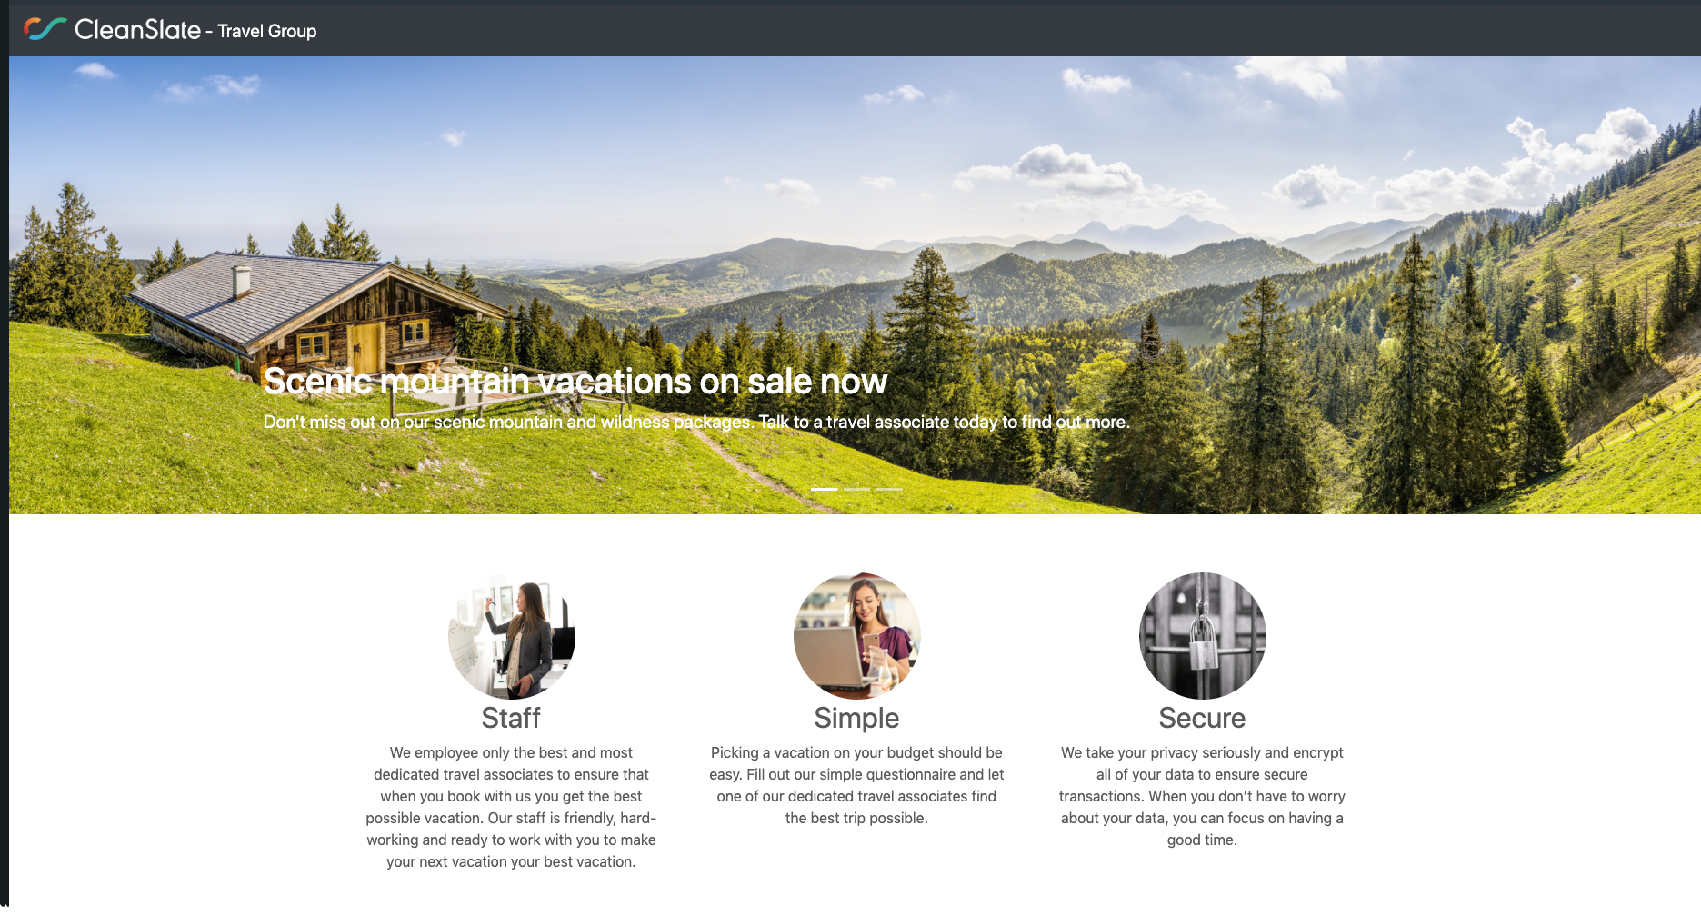
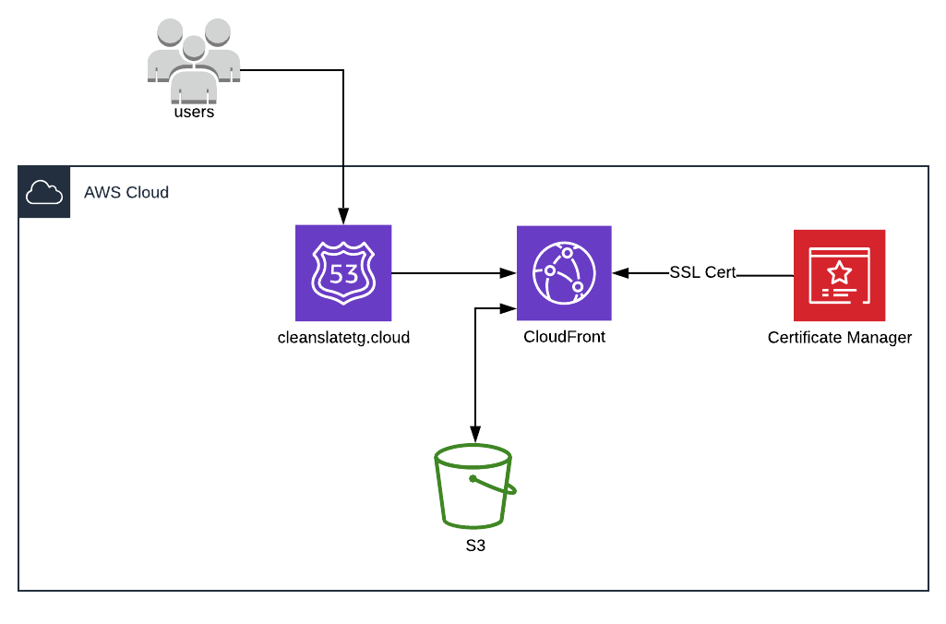
Travel Group

Slide 7
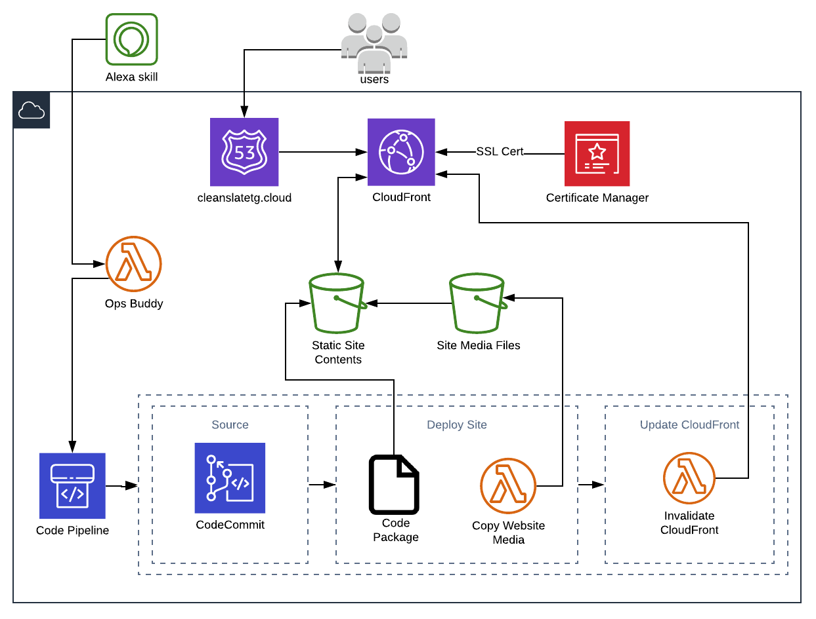
Travel Group
New Features
Git Repo (Code Commit)
CI/CD Pipeline (Code Pipeline)
Upload Media Function (Lambda)
Invalidate CloudFront (Lambda)
Ops Buddy (Alexa Skill)
Ops Buddy (Lambda)

Slide 8
Ops Buddy
Deploy New Changes – Copyright Update
Steps
Update Copyright in code and check in
Check the status of the last deployment
Ensure that the site is healthy
Deploy to Production
Test the site

Slide 9
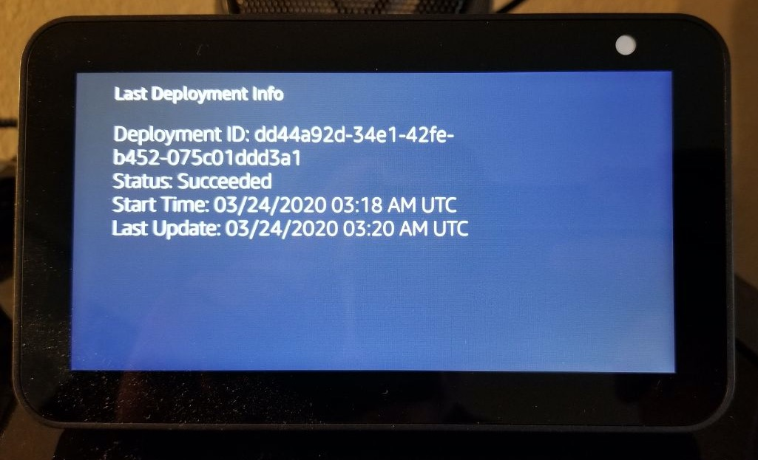
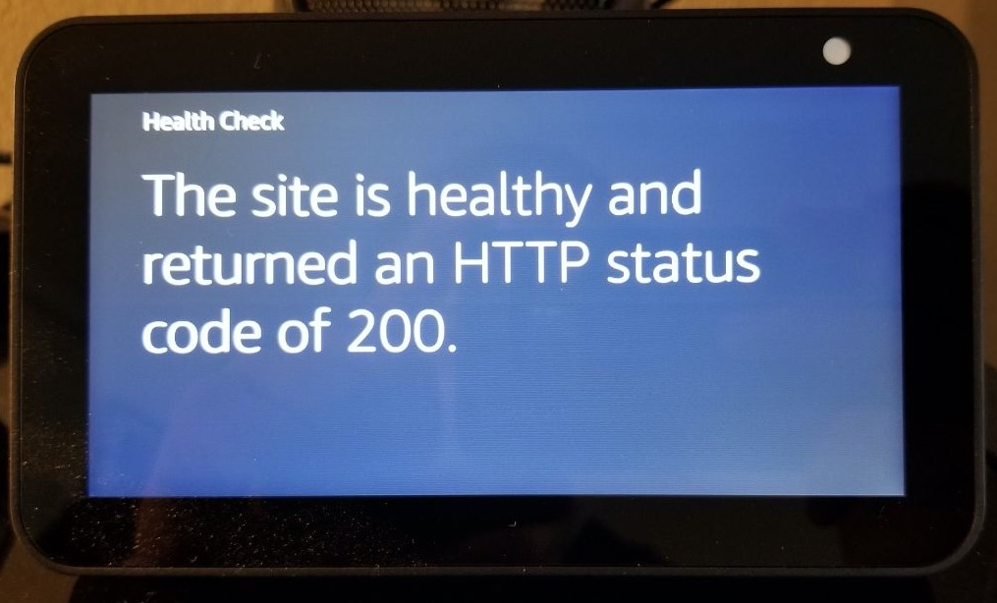
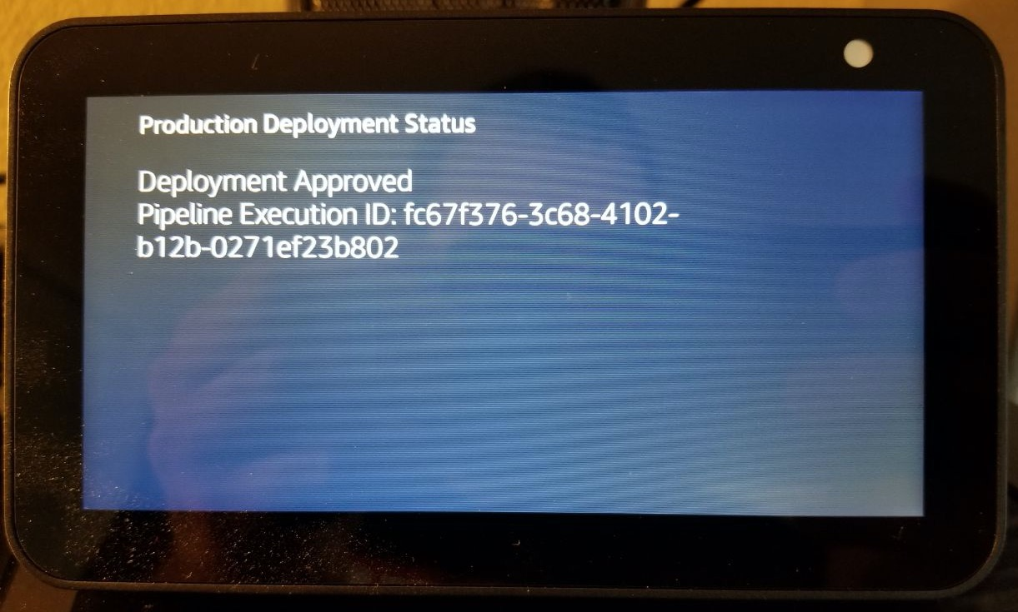
Ops Buddy
Feature Screens
Steps
Check the status of the last deployment
Ensure that the site is healthy
Deploy to Production

Slide 10
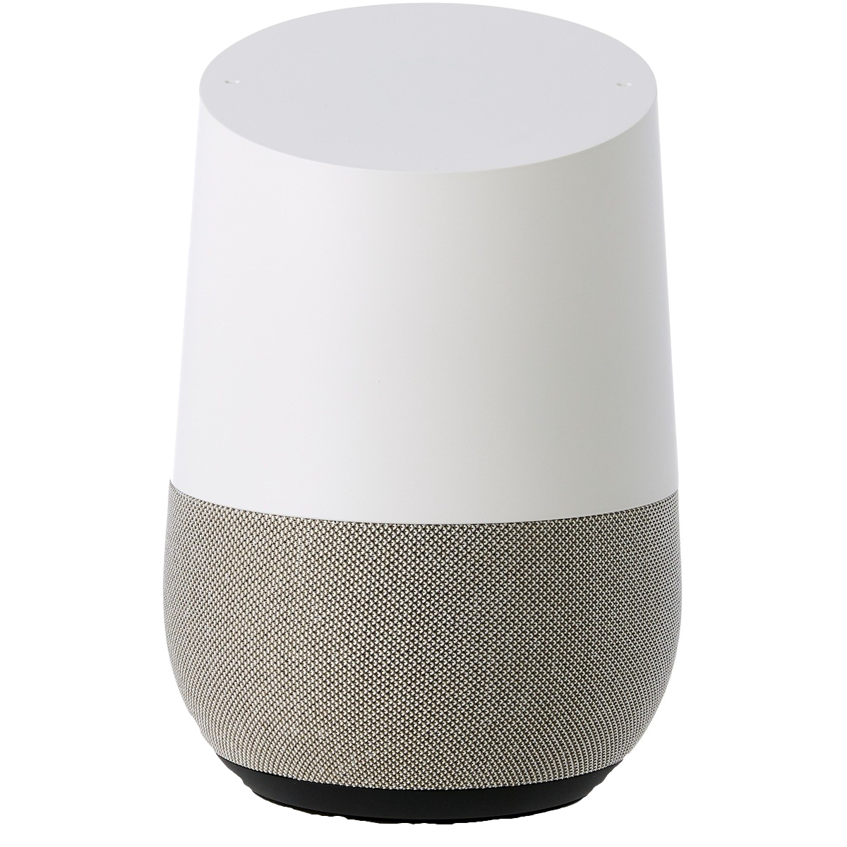
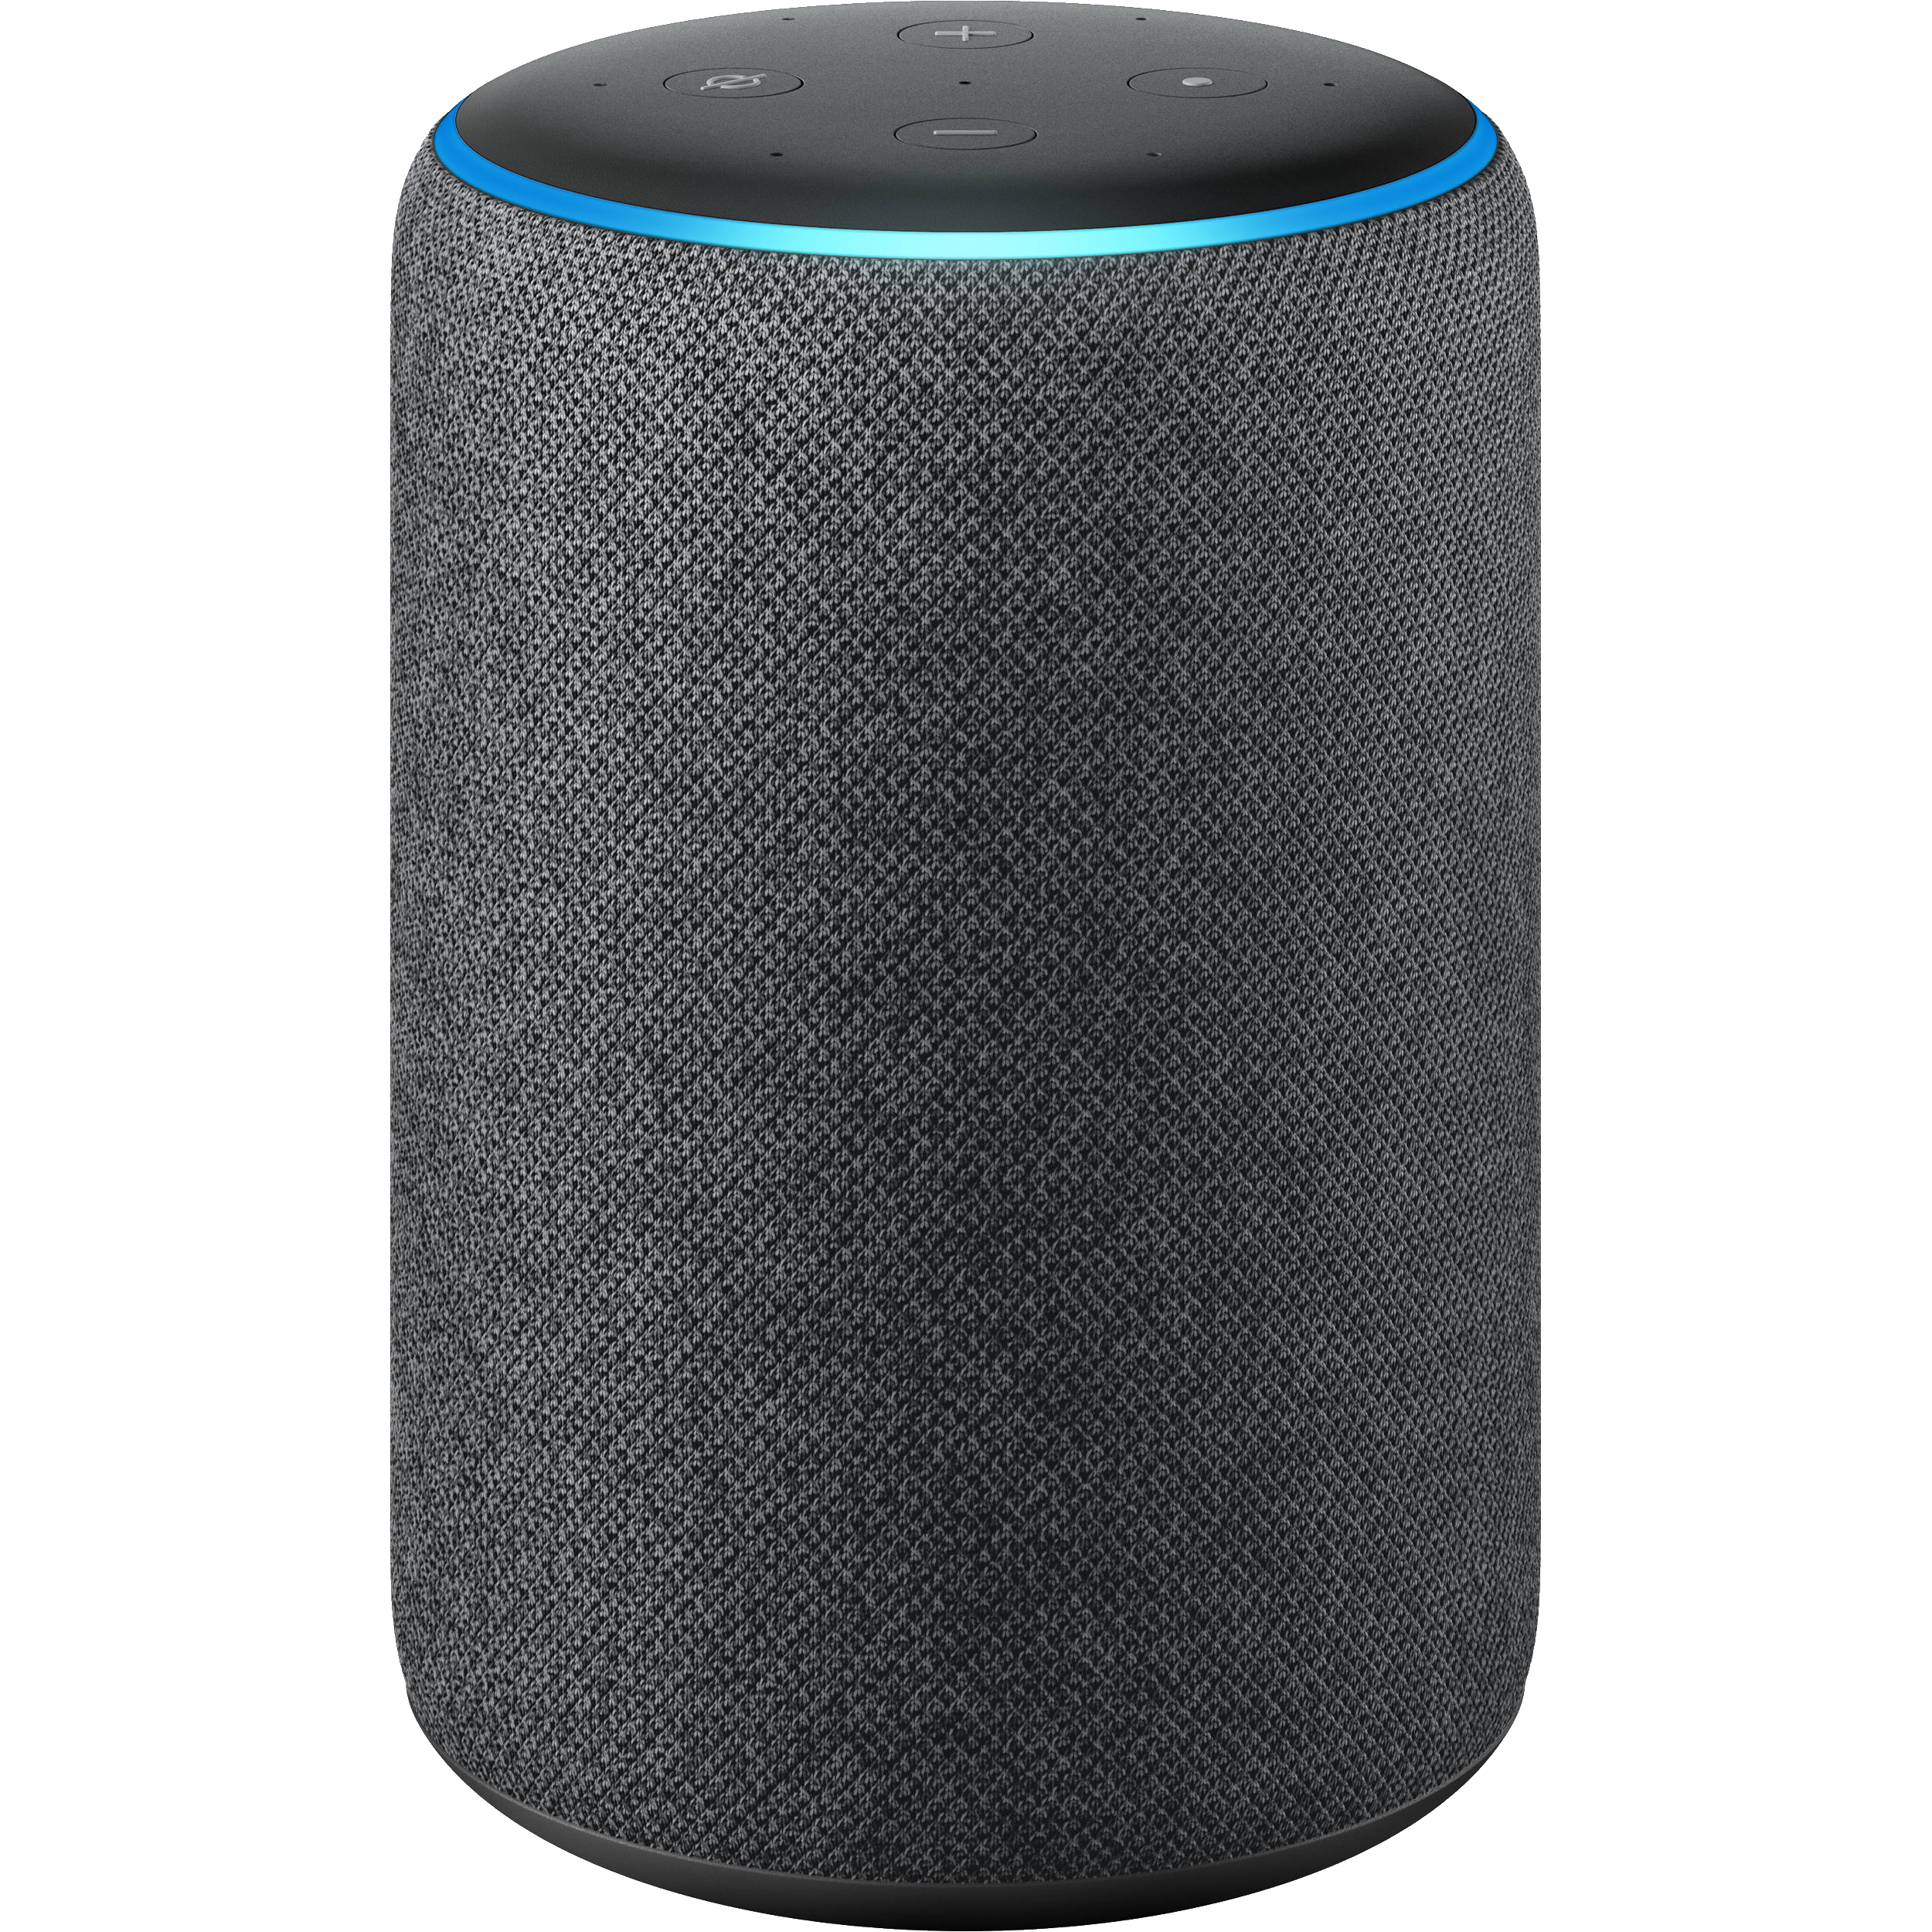
Why use voice apps
Widespread adoption
Can provide a simpler, more intuitive way of interaction
Devices are plentiful
Amazon Alexa
Google Home
Microsoft Cortana
Apple’s Siri
Smart TVs
Can be used for Chat Ops

Slide 11
Chatops
What is ChatOps?
A form of automation and interaction with scripts, tools or code using conversation driven development
ChatOps tools are often called bots
Meant to be accessible from primary sources of conversation
Slack
Teams, Etc…
Helps to easily automate and manual tasks
Existing ChatOps Frameworks
Hubot
Lita
Err
Webhooks

Slide 12
Why Alexa
Alexa is the leader in smart speakers
Devices are plentiful
Variety of devices
Relatively inexpensive
Integrates easily into AWS
Business grade options
Alexa for Business
Meeting room assistant
Private skills

Slide 13
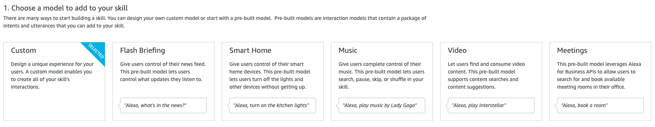
About Alexa
Alexa vs Echo
Alexa is Amazon’s Voice Service
Can be uses on various hardware
Echo
Amazon hardware specialized to work with Alexa
Multiple Types of Skills
Custom Interactions
Smart Home
Flash Briefing
Video
Music
Etc…

Slide 14
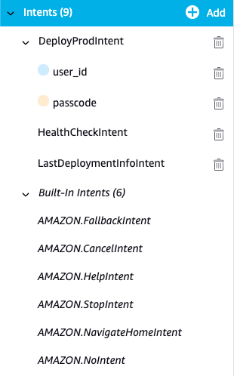
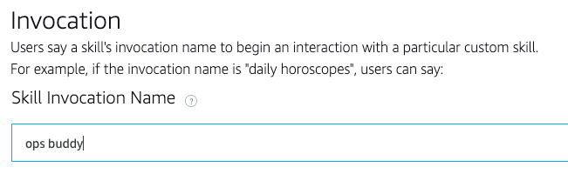
Components of Alexa
Alexa Skill Continued
Alexa Skill
Alexa Developer Console
Invocation Name
Name associated to your app to launch it (Example: Alexa Open Ops Buddy)
Intents
Alexa does not provide exactly what a user says, it instead interprets what a user says and triggers the intent it believes the user was trying to call
Two Types of Intents
Custom: User created intents / hooks for integrating with code
Built In: Intents that Amazon provides (Example: AMAZON.CancelIntent)

Slide 15
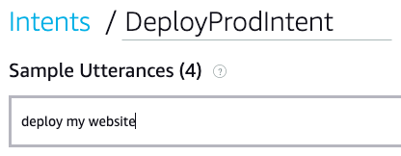
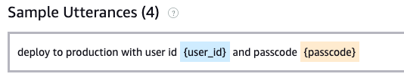
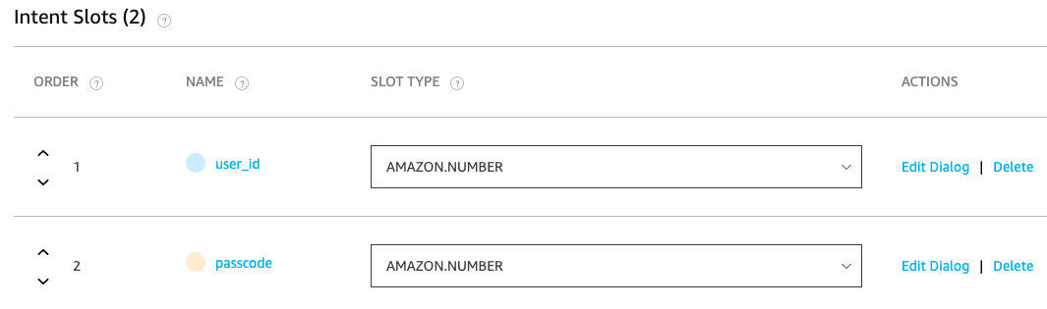
Components of Alexa
Alexa Skill Continued
Alexa Skill
Alexa Developer Console
Components
Utterances
Sample phrases for triggering an intent (Example: Is my website healthy?)
Slots
Placeholders for retrieving specific pieces of data
Integrated with Sample Utterances
Slots have data types

Slide 16
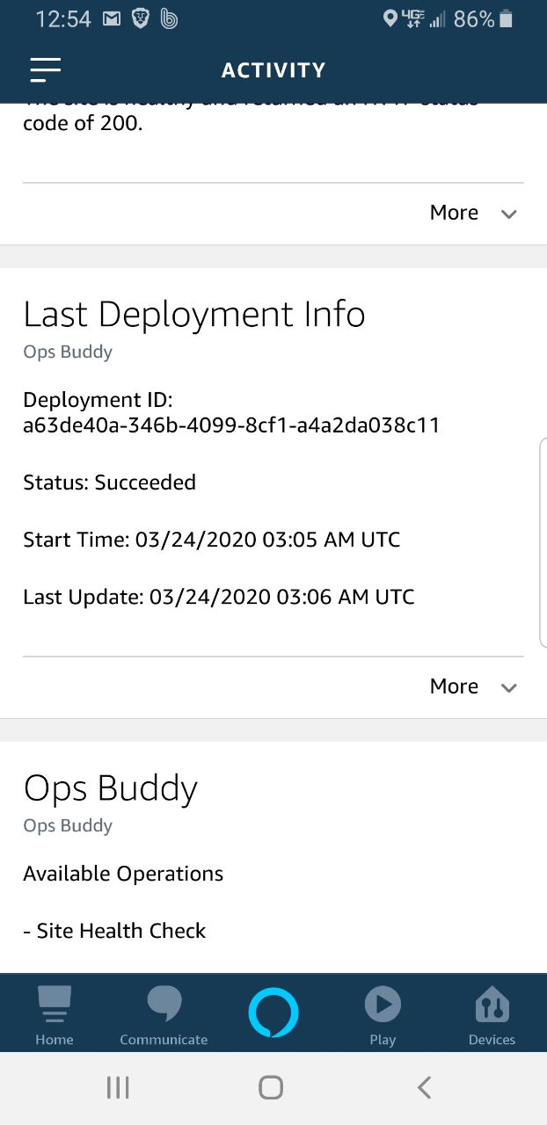
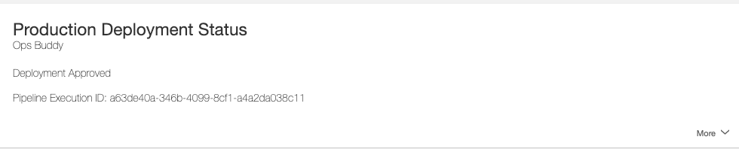
Components of Alexa
Alexa Skill Continued
Alexa Developer Console
Cards
Cards are how data is visually presented back to a user
Can be viewed on Alexa enabled device with a screen
Can be viewed in the Alexa mobile app or alexa.amazon.com

Slide 17
Components of Alexa
Alexa Skill Continued
Alexa Developer Console
Speech Synthesis Markup Language (SSML)
Used to generate output speech for Alexa and controls how that speech is generated
Multiple effects can be added for better voice interface
Emotion: Cause emotion to be added to output speech
Break: Allow for pauses to be added to speech
Say-as: Tells Alexa how to pronounce things such as dates or times

Slide 18
Components of Alexa
Alexa Skill Continued
Alexa Developer Console
Endpoints: Settings for binding Alexa Skill to backend code
Ops Buddy uses AWS Lambda
Infrastructure
Alexa integrates easily into AWS Lambda
AWS Lambda can be used to do almost anything
Logs are available in AWS CloudWatch
Code
Alexa Skills Kit (ASK SDK)
REVIEW OPS BUDDY!

Slide 19
What’s Next
Publish a Skill
Private Skills
Development Skills: Private to only the developers account
Alexa for Business: Publish to organization
Public Skills
Publish to the Skills Library
Make public to the Alexa community
Add Authorization
Build Different types of Skills
Just Go Build!

Slide 20



LET’S CONNECT
STEP ONE
STEP TWO
STEP THREE
Download Presentation Materials
Get Started with Code
Read and get hands on with proven resources
Learn & Build your own Skills
Connect with me and get involved with the community
Get Connected / Get Involved
https://bit.ly/2xsKvLC
https://bit.ly/3dvG5nC
https://bit.ly/3dxWs2T
Stephen Sailor stephen.sailor@cleanslatetg.com
THANK YOU
#sponsor-cleanslate

Slide 21
our offer to You
As a THANK YOU for attending one of our speaking sessions, connect with us on our Slack Channel for one of the offers below.
#sponsor-cleanslate
Cloud Optimization Assessment with CloudCheckr - This evaluation will provide key recommendations for cloud cost optimization that will result in immediate savings opportunities – up to 30% cost savings
Cloud Strategic Planning Workshop – This workshop will introduce our proven Cloud Strategic Planning Framework and highlight the steps necessary to achieve successful cloud adoption including implementation of Cloud Architecture, Security, and Dev/Ops
Notes:
We'd like to thank you for attending this session. As a thank you, CleanSlate would like to make aware of some special offers for all attendees that we have found provide great value.
The first is offering is focused on Cloud Cost Optimization – everyone wants to save money!
The second is our planning workshop which is designed to help you build a strategy to get the most of your cloud investment
If you're interested, please head over to the CleanSlate Slack Channel and someone will connect with you.

